Slide 1
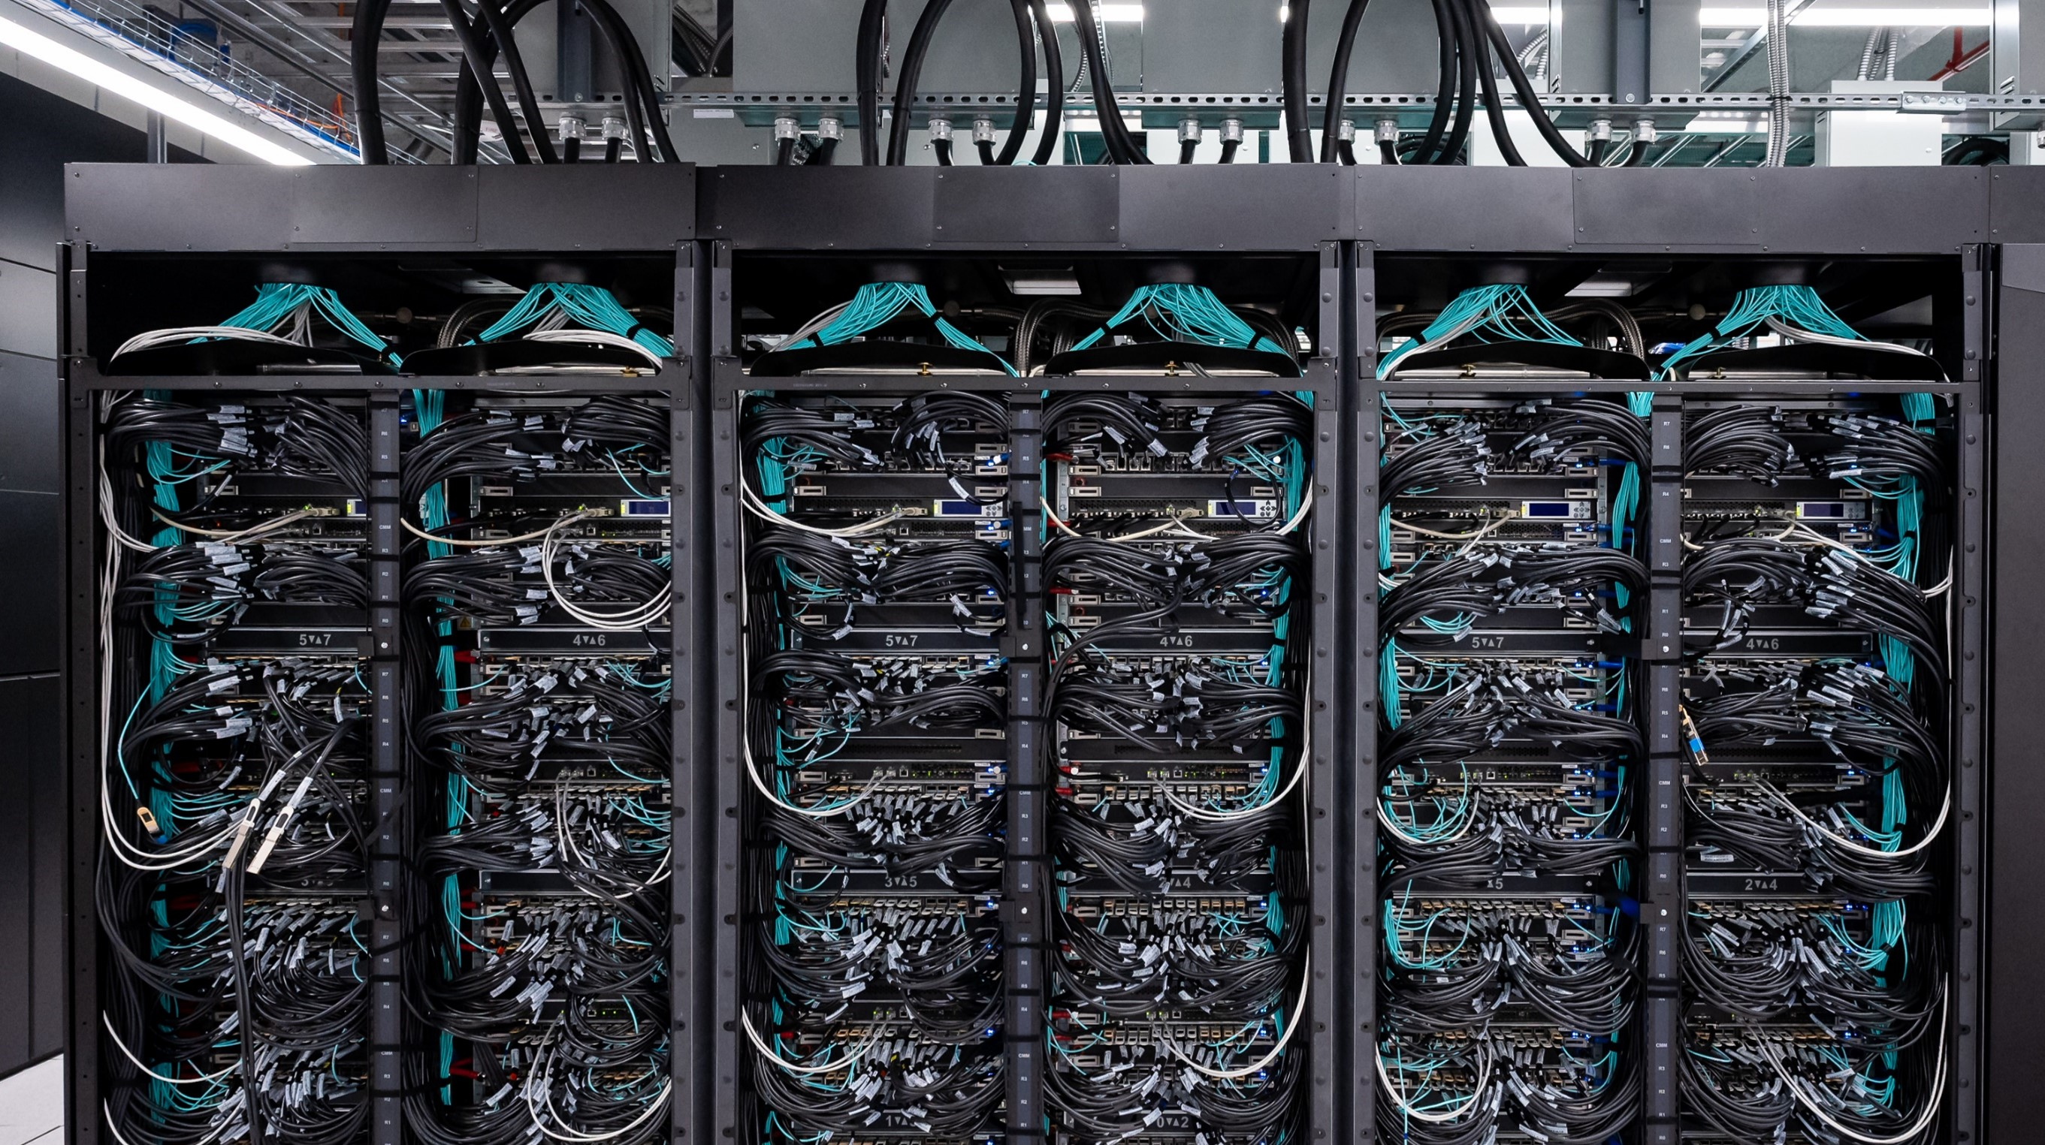
Integrating IPv6 into the curriculum
Topics
Where should we be integrating IPv6?
An IPv6-first approach
Projects
Related modules
Benefits and Challenges
Graeme Bragg
gmb@ecs.soton.ac.uk
Electronics & Computer Science
University of Southampton

Slide 2
Where should we be integrating IPv6?
Everywhere…
From basic networking modules to substantive projects
It also has a place in other modules that use networking, e.g. programming, distributed systems, HPC, web development, IoT, sensor networks, embedded systems, etc.

Slide 3
Finding the Time…
Many of the courses I’ve looked at only touch on IPv6 at a high level
  One lecture if we are lucky, but sometimes it’s just a passing mention that IPv6 exists.
There is a lot of IPv6 content to cover and we all know that there is not enough time for the material we already have, so how do we fit this all in?
With a little restructuring and an IPv6 first approach.

Slide 4
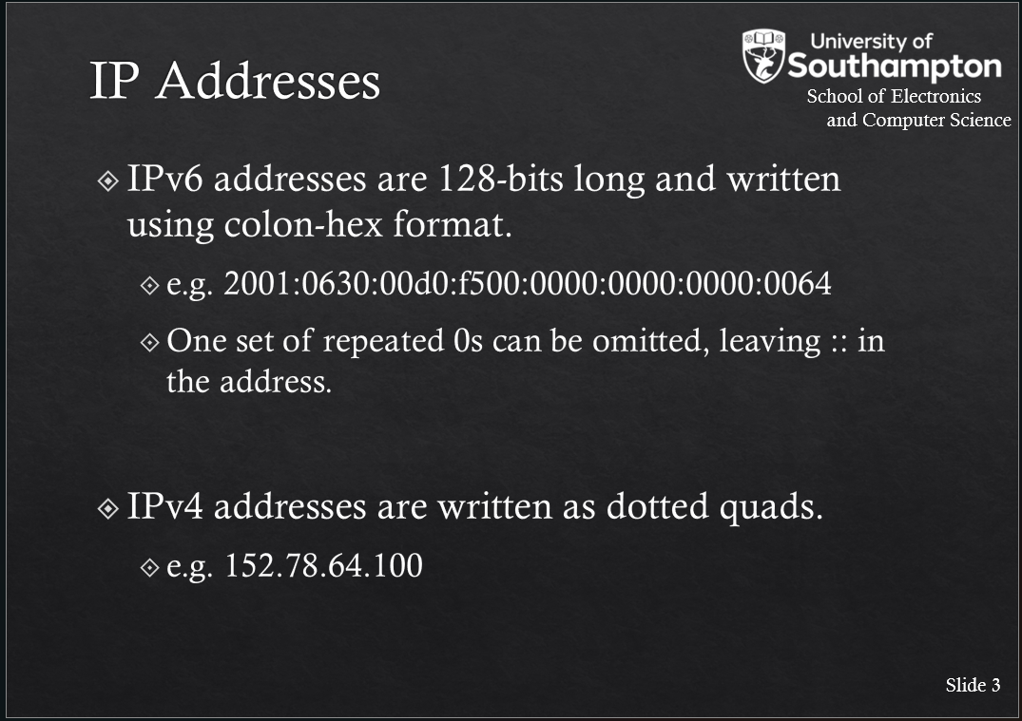
An IPv6-first approach
At Southampton, we take an “IPv6-first approach” for CS, Software Engineering and AICE.
The IPv6 version of something is introduced first or at the same time as IPv4.
Most examples use IPv6.
IPv4 is only used where it makes things simpler or for IPv4-specific concepts
Labs are IPv6.

Slide 5
Make Assessment IPv6 Focused
Assessment needs to change to focus on giving students the opportunity to play with IPv6
Labs focus on IPv6 and do as much as possible in IPv6
  Sniffing IPv6 traffic instead of IPv4
  Comparing IPv6 behvaiour to IPv4
  Working with IPv6 resources
Coursework needs a similar approach (Generative AI also currently struggles with IPv6…)

Slide 6
Substantive Projects/Dissertations
When students have been exposed to IPv6, some of them want to do their individual project/dissertation on it, or even substantive group projects.
It helps to have a few ideas before you are asked. A few topics I’ve supervised over the years:
  IPv6 traceroute visualisation tool
  Assessment of IPv6 reconnaissance algorithms
  Exploration IPv6 extension header support on the Internet
  Assessment of default IPv6 security configuration of devices
  Wireless sensor networks/IoT devices/embedded systems

Slide 7
Related Modules
Networking modules aren’t the only modules that expose students to networking and IP addresses:
  Software development
  Embedded systems
  IoT
  Distributed systems
  Security
Making sure these modules leverage IPv6 is another challenge because networking isn’t always the focus and there are a lot of IPv4-centric tutorials and guides.

Slide 8
Benefits
Students are exposed to IPv6 addresses early
  Gets over the “This is scary and long” problem.
Students see the simplicity of IPv6 first rather than IPv4 complexities.
Students can focus more on fundamental network concepts and we find they have a better understanding of the basics.

Slide 9
Challenges
Getting buy-in from other colleagues
  Some networking courses have not changed substantially for years or decades – covering IPv6 may require a significant restructure and re-write of material
  Many lecturers don’t have any IPv6 experience
Getting appropriate IT provision to support learning, labs and coursework. (More on this later from David)
Student behaviour/expectations/existing knowledge
  Students with existing IPv4 knowledge sometimes struggle more
  Many tutorials and generative AI output focus on IPv4, so even if you clearly say “this is an IPv6 lab…”

Slide 10
Thoughts? Questions? Comments?

Slide 11
IPv6 Lab Experience
Time to do something practical!
This lab experience is inspired by the basic networking labs all our Part I CS and Part II AICE students do.
Obviously this is designed for a controlled lab environment and your laptops are not that, so forgive any hiccups! Give it all a go and let’s work out the pitfalls.
The lab can be found on Github (yes, the irony…):

