Slide 1
IPv6 technical primer
Tim Chown, Jisc (tim.chown@jisc.ac.uk)
UK IPv6 Council Workshop, 11 August 2026

Slide 2
IPv6 – a teaching perspective
A “new” IP layer
IPv6 is still IP
The principles previously used to teach TCP/IP largely still hold
  The layered model, TCP/UDP over IP
  Routing and forwarding, with IP over various media formats
  Congestion control
  IPv6 slots in as an alternative to IPv4
But IPv6 has many differences
You could teach “IPv6 first”
  It’s the dominant user protocol, students will have seen it at home

Slide 3
Deployment status and measurement
FAQ: How much user traffic is IPv6?
There are many measurements out there for IPv6 deployment, e.g.:
  http://www.worldipv6launch.org/measurements/
  https://labs.ripe.net/Members/mirjam/content-ipv6-measurement-compilation
We’re just hitting the point where >50% of user traffic is IPv6
IPv6 adoption varies by sector: residential, mobile, enterprise
Janet IPv6 traffic sits at under 10%
R&E is well behind commercial adoption
  We should still be teaching it, given ~50% of the user traffic is IPv6
  And campuses deploying it to support research, e.g., the CERN sites

Slide 4
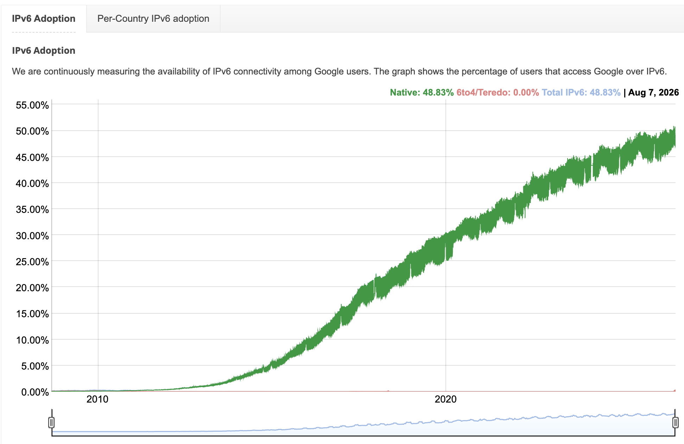
World adoption, as seen by Google
https://www.google.com/intl/en/ipv6/statistics.html - the UK is currently at 54.4%

Slide 5
IPv6 topics?
What do we need to consider?
Origins
IPv6 addressing
  Obtaining, managing and configuring addresses
IPv6 protocols
  Standards specifics – stateless autoconfiguration, etc.
Breaking IPv4 thinking
  Highlighting the key differences
Operational considerations
  New capabilities required, interoperation with IPv4
IPv6 Security

Slide 6
Origins
Within the IETF

Slide 7
The Internet Engineering Task Force (IETF)
Standardisation
The IETF sets standards for network and transport layer protocols
  IP, TCP, congestion control, routing, …
  More recently TCP-BBR, QUIC, …
Operates through working groups (WGs) across many Areas
  https://www.ietf.org/technologies/areas/
  Open participation, mail lists, in-person meetings, no fees
Uses “rough consensus and running code”
Produces RFCs. Just published RFC 10000.

Slide 8
IPv6 in the IETF
For over 30 years
Most work done in 6man (was ipng, ipv6) and v6ops WGs
RFC 1883, RFC 2460, RFC 8200 (Internet Standard)
New features were captured in RFC 1883 (in 1995)
  Expanded addressing, simplified headers format, improved extension support, flow labelling, CIA support
This was coupled with a desire to support improved autoconfiguration of large-scale networks
  Stateless address autoconfiguration for devices (SLAAC)
  Fate-sharing: hosts derive config from their router

Slide 9
IPv6 addressing
Format, obtaining and address planning

Slide 10
IPv6 Addressing
What changes with IPv6?
IPv6 addresses are 128 bits
The notation used to write addresses is different to IPv4
  e.g., 2001:db8:e380:d0:920a:2380:b230:1106
Defined by RFC4291, and includes different scopes of addresses
  Link-local (under fe80::/10) – on a link, not routed
  Unique Local Addresses (ULAs, under fc00::/7) – for intra-site use
  Globally unique addresses (GUAs)
Multi-addressing is the norm - more later

Slide 11
Writing IPv6 addresses
And abbreviating them
As we just saw, IPv6 addresses are written as eight sets of four hexadecimal characters, e.g.
  2001:0db8:0000:0000:baad:cafe:1234:5678
To abbreviate, you can omit any leading zeros in any set of four
  2001:db8:0:0:baad:cafe:1234:5678
And you can replace one series of :0: fields with ::
  The above example can be 2001:db8::baad:cafe:1234:5678
  … but why only one?
    Consider 2001:db8::baad::1234:5678

Slide 12
Obtaining address space
Hierarchical management
IPv6 address allocation and assignment policies are determined by the Regional Internet Registries (RIRs), and their members, which for us is RIPE
  See https://www.ripe.net/publications/docs/ripe-738
ISPs can obtain blocks of addresses through being Local Internet Registries (LIRs)
  The default allocation is a /29, usually as an initial /32
ISPs can then assign space to customers
Note that unused IPv4 address space is severely limited (/24s)

Slide 13
Janet example: Jisc as a university’s ISP
Connecting to Janet with IPv6
The Janet backbone is dual-stack throughput
IPv6 is available natively as part of the Janet IP Connection service
As an LIR, Jisc obtained the prefix 2001:630::/32 from the RIPE NCC in 1999 (was a /35 back then, now the default is /32 with a /29 reserved)
  Jisc can provide sites an IPv6 prefix for their organisation on request
  Default prefix assignment to a Janet-connected site is a /48
  A site can make a case for more
A handful of universities have become LIRs, to obtain their own /29
  Jisc will still route whatever prefix a member site is using

Slide 14
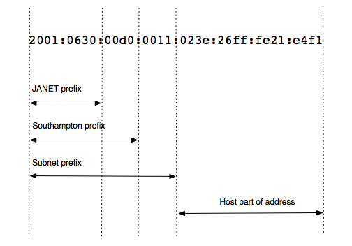
IPv6 prefix assignments
From Jisc to its member/customer sites
A typical prefix breakdown for a university or college site might be:
NB: the ISP and site prefix lengths here are just defaults
A Janet site may thus have up to 2^16 host subnets
Host subnets are 64 bits due to SLAAC

Slide 15
Address planning
How a site chooses to use its IPv6 assignment
A similar process to IPv4
Subnetting will typically follow geographic or administrative boundaries
Lots of ‘clever’ things you can do because the bits are there
  Nice guide written by SURFnet over 10 years ago
  https://www.ripe.net/support/training/material/IPv6-for-LIRs-Training-Course/Preparing-an-IPv6-Addressing-Plan.pdf
As mentioned before, all IPv6 host subnets are /64 due to SLAAC
A site will likely have congruent IPv4 and IPv6 prefixes
  The rationale for subnetting is the same either way
  But IPv4 subnets may vary in size over time (/24, /27, /22,…)

Slide 16
Address planning
Other considerations
How big do you wish to make layer 2 subnets?
  If you go very big (esp. a flat layer 2 campus!) then there will be a lot of ‘chatter’ traffic from IPv4 ARP, IPv6 Neighbour Discovery (ND), etc
  At the other extreme, RFC 8273 describes using a prefix per host for IPv6
Consider whether all devices in a subnet will be configured the same way
  RAs provide the same information to all hosts
Will you use ULAs?
  It may be tempting for systems you know do not communicate off site
  But I don’t know of any Janet sites doing so (not that ULAs would be seen…)
Use /127 for point-to-point as per RFC 6164 (but you can reserve a /64)

Slide 17
IPv6 fundamentals
Protocol specifics – packet formats, new protocols

Slide 18
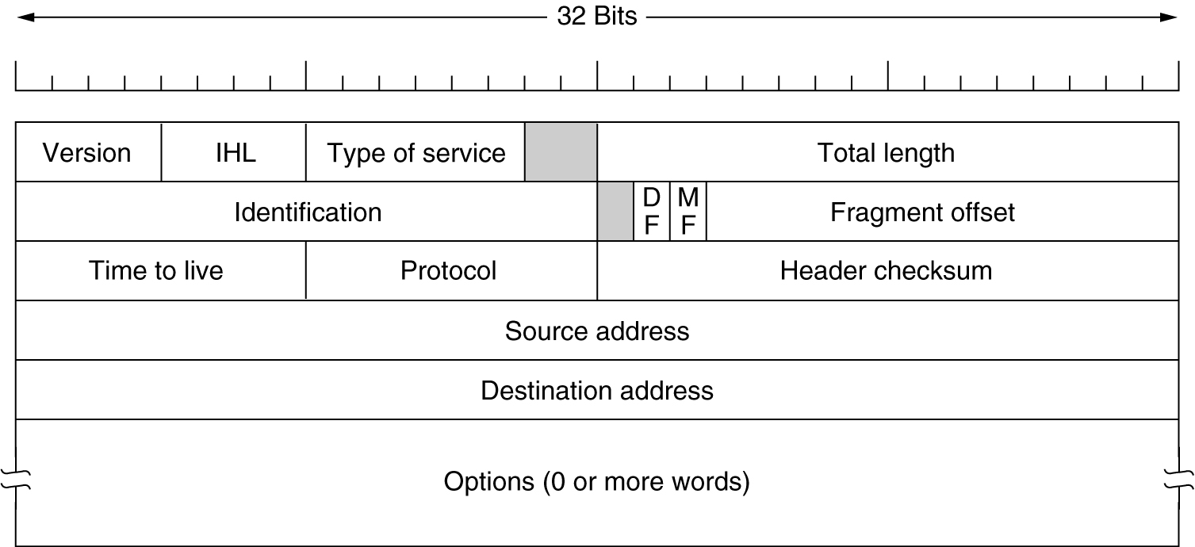
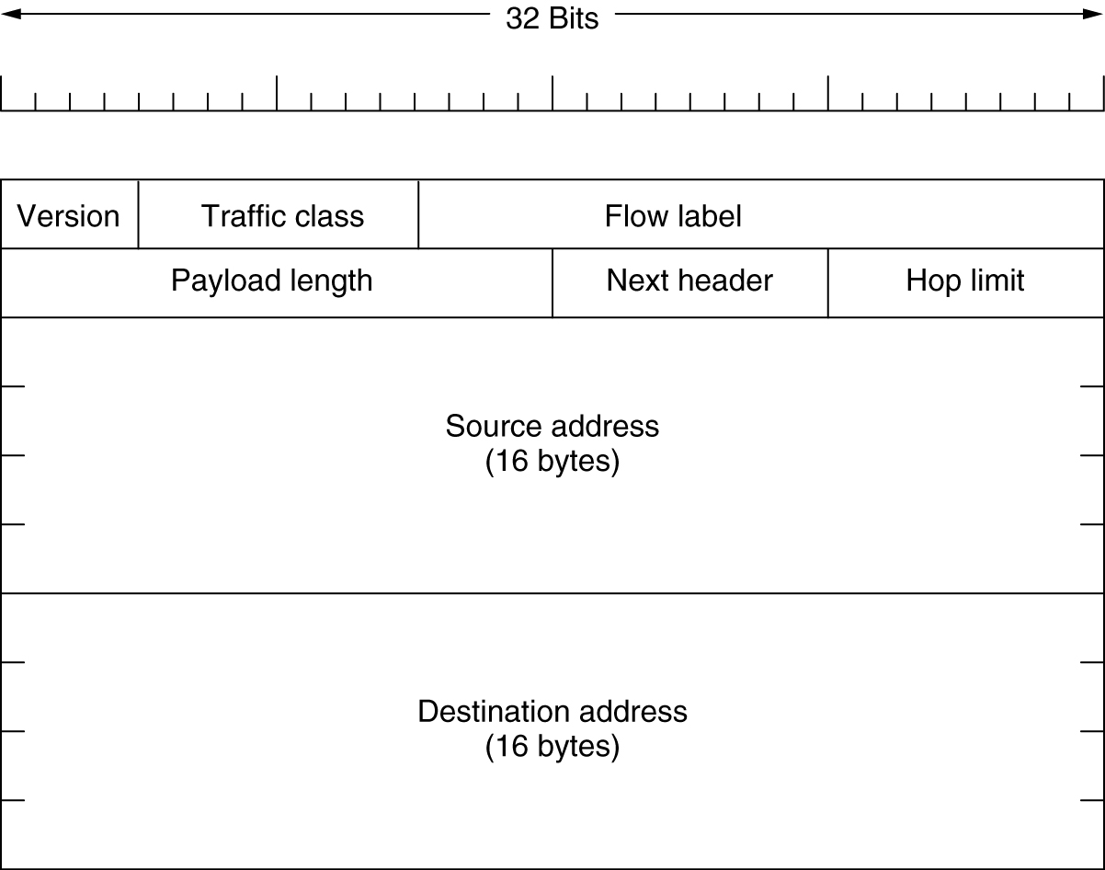
IPv6 packet format
Streamlined format
Defined in RFC 8200
Some headers have IPv4 counterparts
New: 20-bit flow label (RFC 6437)
  Random, unique per flow
IPv4 and are IPv6 NOT compatible
  No direct IPv6-only to IPv4-only
  Need some form of translation to talk
  But can run both, as “dual-stack”

Slide 19
IPv6 Extension Header (EH)
Flexible headers
A streamlined, fixed length main header
BUT with a chain of optional EHs, e.g.:
  Fragmentation header
  IPsec headers, …
Header ordering is important
EHs can be problematic (RFC 7872, RFC 9098)
  Drops do occur for packets with EHs on wider internet
  Site firewalls may be configured to drop unrecognised EHs
  Nodes should forward all EHs (RFC 7045, RFC 9673)
Most traffic has no EH present

Slide 20
Aside: robustness principle
Postel’s Law
First used in the early specs for TCP/IP:
  “be conservative in what you do,
  be liberal in what you accept from others”
A principle that can be applied in many network scenarios

Slide 21
IPv6 Neighbour Discovery
Discovering on-link hosts and routers
No ARP in IPv6
Instead uses multicast (under ff00::/8) ICMPv6 – see RFC 4861
  The messages are layer 3 rather than layer 2 (like ARP broadcasts)
  IPv6 also does not have IP subnet broadcast addresses
Sits with the fate-sharing principle that hosts and routers can learn about each other by local messaging
  A host learns which router(s) are available
RFC 4861 includes the conceptual model of a host
  Neighbour cache, destination cache, prefix list, default router list
Maintains reachability information

Slide 22
ND messages
A suite of 5 link-local messages
Neighbour Solicitation (NS) and Neighbour Advertisement (NA)
  Like ARP for IPv4; finds the MAC address for an IP
  Includes Duplicate Address Detection (DAD) for tentative addresses
Router Solicitation (RS) and Router Advertisement (RA)
  Hosts can ask all routers to send an RA
  RAs pass hosts information about routers on their link
  RAs can include an ‘M’ bit to say ‘use DHCPv6’
Router Redirect

Slide 23
ND considerations
In practice
ND can be unreliable on certain media, notably WiFi
ND issues are captured in RFC 9898
  Reliability – frequency of messaging, potential unicasting
  Isolation – security, led to prefix-per-host work
  Neighbour cache exhaustion
Many mitigations discussed there – some good material
RFC 7772 talks about power consumption for RAs/ND

Slide 24
Configuring addresses
New: stateless autoconfiguration (RFC 4862)
IPv6 supports the choice to use the “comfy slippers” of DHCPv6
It also introduces stateless address autoconfiguration (SLAAC)
  SLAAC implicitly means all host subnets are /64 in size
  IPv4 essentially has variable length subnets (to save address space)
  It’s widely used in the campuses who have already deployed
  Only a handful are using DHCPv6, so far
Or you can configure addresses manually or through automation

Slide 25
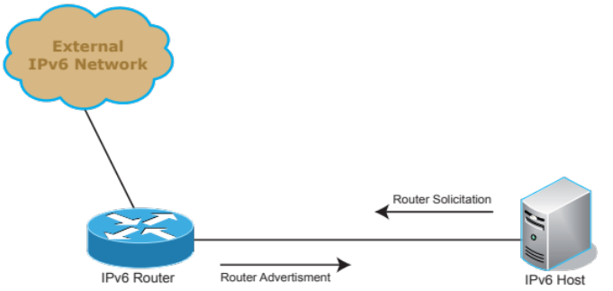
SLAAC
IPv6 address autoconfiguration
Router periodically sends an RA, or hosts can solicit one with an RS
  Information in the RA has an associated preferred / valid lifetime
Host configures its address using the 64-bit network prefix in the RA
  The host part of the address (last 64 bits) should be set by RFC 7217 to be a unique ‘random’ value per prefix it attaches to
RAs also allow hosts in the same subnet to configure default router, DNS (with RFC 8106), MTU, and on-link prefixes
SLAAC means IPv6 has 64-bit host subnets
  A de-facto default, even with DHCPv6
  See also RFC 7421 on “Why /64?”

Slide 26
IPv6 temporary / privacy addresses
Designed to improve user privacy
A host can additionally configure a temporary address (RFC 8981, was 4941)
  Used as source address when sending, usually not put in DNS
Originally designed for cases when the host part of the address embedded the device’s 48-bit MAC address (with 16 bits of ‘fffe’ padding in the middle)
  Facilitated tracking when connecting to different networks
  Less important since the introduction of RFC 7217
Privacy addressing is generally turned on by default
  May also generate new privacy addresses over time for immobile devices
  Typically disable for servers and on managed systems
  No way to forcibly disable for BYOD
Good for users, but adds challenges for management

Slide 27
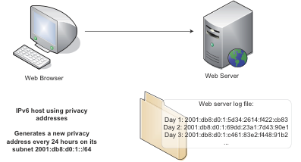
The privacy address challenge
Are those addresses different hosts, or one host with many addresses?
Consider a client and a web server

Slide 28
Example 1
Staff Mac laptop
$ifconfig en7
en7: flags=8863<UP,BROADCAST,SMART,RUNNING,SIMPLEX,MULTICAST> mtu 1500
options=6467<RXCSUM,TXCSUM,VLAN_MTU,TSO4,TSO6,CHANNEL_IO,PARTIAL_CSUM,ZEROINVERT_CSUM>
ether 9c:eb:e8:c1:49:13
inet6 fe80::105a:2384:34ee:23f9%en7 prefixlen 64 secured scopeid 0xe
inet6 2001:db8:d510:1101:184a:98b6:aaf4:3e52 prefixlen 64 autoconf secured
inet6 2001:db8:d510:1101:ac8c:fe54:7923:4fc9 prefixlen 64 autoconf temporary
inet 192.168.0.12 netmask 0xffffff00 broadcast 192.168.0.255
nd6 options=201<PERFORMNUD,DAD>
media: autoselect (1000baseT <full-duplex>)
status: active

Slide 29
Example 2
CentOS server
Config example for ps-slough-10g.ja.net
Manually configured IP, no temporary addresses
$ ifconfig em1
em1: flags=4163<UP,BROADCAST,RUNNING,MULTICAST> mtu 1500
inet 194.81.18.229 netmask 255.255.255.254 broadcast 255.255.255.255
inet6 2001:630:3c:f803::a prefixlen 126 scopeid 0x0<global>
inet6 fe80::d294:66ff:fe4c:37bf prefixlen 64 scopeid 0x20<link>
ether d0:94:66:4c:37:bf txqueuelen 10000 (Ethernet)

Slide 30
Multi-addressing
With IPv6, this is now the norm
A host may have many addresses with IPv6:
  IPv6 link local, global, multiple privacy
  And IPv4 (private or global) on a dual-stack host
RFC 7934 advocates for multi-addressing
Implies the need for address selection – RFC 6724
  Prefer IPv6, prefer matching scope, longest prefix match, …
Introduces address accountability challenges
  Which addresses are being used by which devices/users?
  Interesting to discuss approaches

Slide 31
DHCPv6
The more familiar configuration method
Stateful DHCPv6
  For full device configuration, as per RFC 8415 (was 3315)
  Various options for DHCPv6 Unique Identifiers (DUIDs), including RFC 6939 to key addresses to MAC addresses and use a relay
Stateless DHCPv6
  For ‘other configuration information’ – NTP, DNS, …
Still need RAs for default router and on-link prefixes
  No IPv6 default gateway option for DHCPv6
No DHCPv6 for Android – an issue for IPv6-only and DHCPv6
  https://issuetracker.google.com/issues/36949085

Slide 32
PMTUD (RFC 8201)
What size MTU to use?
IPv6 only allows fragmentation at the sender
  No DF bit like IPv4
  Therefore, PMTUD must work
The minimum MTU is 1280 bytes
Sender uses its MTU, and drops size to reported MTU from any received ICMPv6 Packet Too Big message received
  It is important these are not filtered, see RFC 4890
Examples of use of 9000 MTU appearing in R&E networks
  Worldwide large hadron collider computing grid (WLCG)

Slide 33
IPv6 node requirements (RFC 8504)
What support is required
Summarises protocol requirements for IPv6 nodes
  Currently being updated (again)
  Though the core IPv6 protocol is stable
A good resource to understand the capabilities required by typical IPv6 hosts
  Relatively silent on constrained devices, snac WG, etc
Includes pointers to specific guidance, e.g.:
  Default router preference (RFC 4191)
  First-hop router selection (RFC 8028)

Slide 34
Routing protocols – a quick note
There are new IPv6-compatible versions
These are well-established
  Multiprotocol BGP (RFC 2545)
  IS-IS (RFC 5308)
  OSPFv3 (RFC 5340)
  RIPng (RFC 2080)
We’d assume routing theory is taught separately – Dijkstra, etc
Most campuses/enterprises probably run OSPFv2 or IS-IS
  Can run OSPFv2 alongside OSPFv3
  Check support for multi-AF (address family) OSPFv3 if looking to use OSPFv3 for both protocols

Slide 35
New: SRv6
Segment routing for IPv6 (RFC 8402)
Allows packets to follow a specific path
Uses Segment Routing Header (SRH) defined in RFC 8754
  Ordered list of segments (SIDs) the packet must traverse
  Segment is a locator and function
RFC 8986 talks of programming SRv6
Used in Multipath Reliable Connection (MRC)
  By OpenAI and others in DCs for resilient AI networking
  RDMA-based, static source routing capability
  Paper: https://arxiv.org/abs/2605.04333 (May 2026)

Slide 36
IPv6 Programming APIs
What changes?
It’s preferable to write software in a way that’s IP version agnostic
Basic Socket Interface Extensions for IPv6 (RFC 3493)
  See also POSIX - https://ieeexplore.ieee.org/document/8277153
Advanced Sockets API (RFC 3542)
Advice depends on language being taught
For C, functions include getaddrinfo() and getnameinfo()
  Check address family specified
  Use appropriate socket options, etc.

Slide 37
Breaking IPv4 thinking
Key IPv6 differences

Slide 38
How do you need to adjust your thinking?
What makes IPv6 different?
The larger addresses and their format
  Need to consider all the places literal addresses appear – see RFC 5952
Multi-addressing is normal
  IPv6 LL, IPv6 GUA, IPv4 (private or global), IPv6 privacy addresses
  Potentially ULAs as well – design choices in whether to use these
    Expired IETF I-D: draft-ietf-v6ops-ula-usage-considerations
Fragmentation is only done by end hosts, not along the path
  Thus need PMTUD to work; RFC 4890 advises on ICMPv6 filtering
Avoidance of NAT, though NAT66 exists

Slide 39
A summary
 | IPv4 | IPv6
Address length | 32 bits | 128 bits
Prefix length | Varies, typically /24 | Always /64 in host subnets
Address configuration | DHCPv4 | Stateless Autoconfiguration DHCPv6
Addresses used | Private or Global | Link-local and Global
Address resolution | ARP | Neighbour Solicitation / Advertisement
Host Path MTU Discovery | Optional | Required
Fragmentation | By hosts or routers | Only by hosts
Private addressing | RFC 1918 | Unique Local Addresses (ULAs) (not designed for use with NAT)

Slide 40
(Unix) Troubleshooting
Not that different, for example:
Tools like ping and traceroute work the same way
Netstat can provide information for either protocol
Wireshark and tcpdump work as expected
  Useful for looking at ND traffic for example, like RAs
You can check an ND cache like an ARP cache
Bad ICMPv6 filtering might impact connectivity / PMTUD
There are some other handy web-based tools
  e.g., https://test-ipv6.com/, https://ipv6-test.com/, https://ip6.nl/

Slide 41
Operational considerations
New capabilities required, IPv4 interoperability

Slide 42
Examples of topics
Questions/decisions for your campus admins
How should IPv4 and IPv6 be integrated?
What level of host/user accountability do you need?
  Will you need new tools to handle the impact of multi-addressing?
What about NAT?
  Do you use it for IPv4? If so, for what reason?
  It’s possible in IPv6, by prefix mapping with NAT66, but not ideal
Do you want to run 9000MTU?
  Janet supports it, and there is a clear performance advantage
  If so, it’s needed end-to-end, and you’ll need to ensure PMTUD works

Slide 43
Tunnelling
Carrying one IP versions’ traffic over the other
Originally multiple tunnelling methods were defined to support connecting between IPv6 ‘islands’ over IPv4
With native IPv6 now pervasive, this need has largely gone away – tunnelling is more often now IPv4 over IPv6
Tunnel brokers can still be handy
  Students might use tunnelbroker.net in their home network
A dual-stack VPN is a form of tunnel broker
  Something to discuss in David’s section on campus support later

Slide 44
Dual-stack
Running both protocols
The common deployment model for campuses is dual stack
Can then use IPv4 to IPv4-only systems, and IPv6 to IPv6-only
Application can pick either protocol for a dual stack destination
There’s “Happy Eyeballs” for browsers (RFC 8305)
    Try IPv4 and IPv6 in parallel, pick the one that connects first
Application protocol selection has proven a challenge for GridPP
  Finding out why IPv4 is used when IPv6 is available
    e.g., a Java preference was not set to IPv6 for dCache
But ideally want to simplify towards IPv6-only end game
  Don’t really want to permanently manage both protocols

Slide 45
Translation
Usually for IPv6 access to legacy IPv4
With a growing interest in running IPv6-only, the focus has shifted to translation for IPv6-only to IPv4-only content
Already widely used in mobile operator networks to handsets
  NAT64/DNS64/464XLAT
IPv6-only client constructs a “fake” IPv6 destination embedding the IPv4 destination address; unpacked by the NAT64 device
Ideally use host-based CLATs, avoid DNS64
  RAs can include PREF64 option so hosts discover the prefix (RFC 8781)
Some ISPs are using alternatives, e.g. MAP-T (RFC 7599)

Slide 46
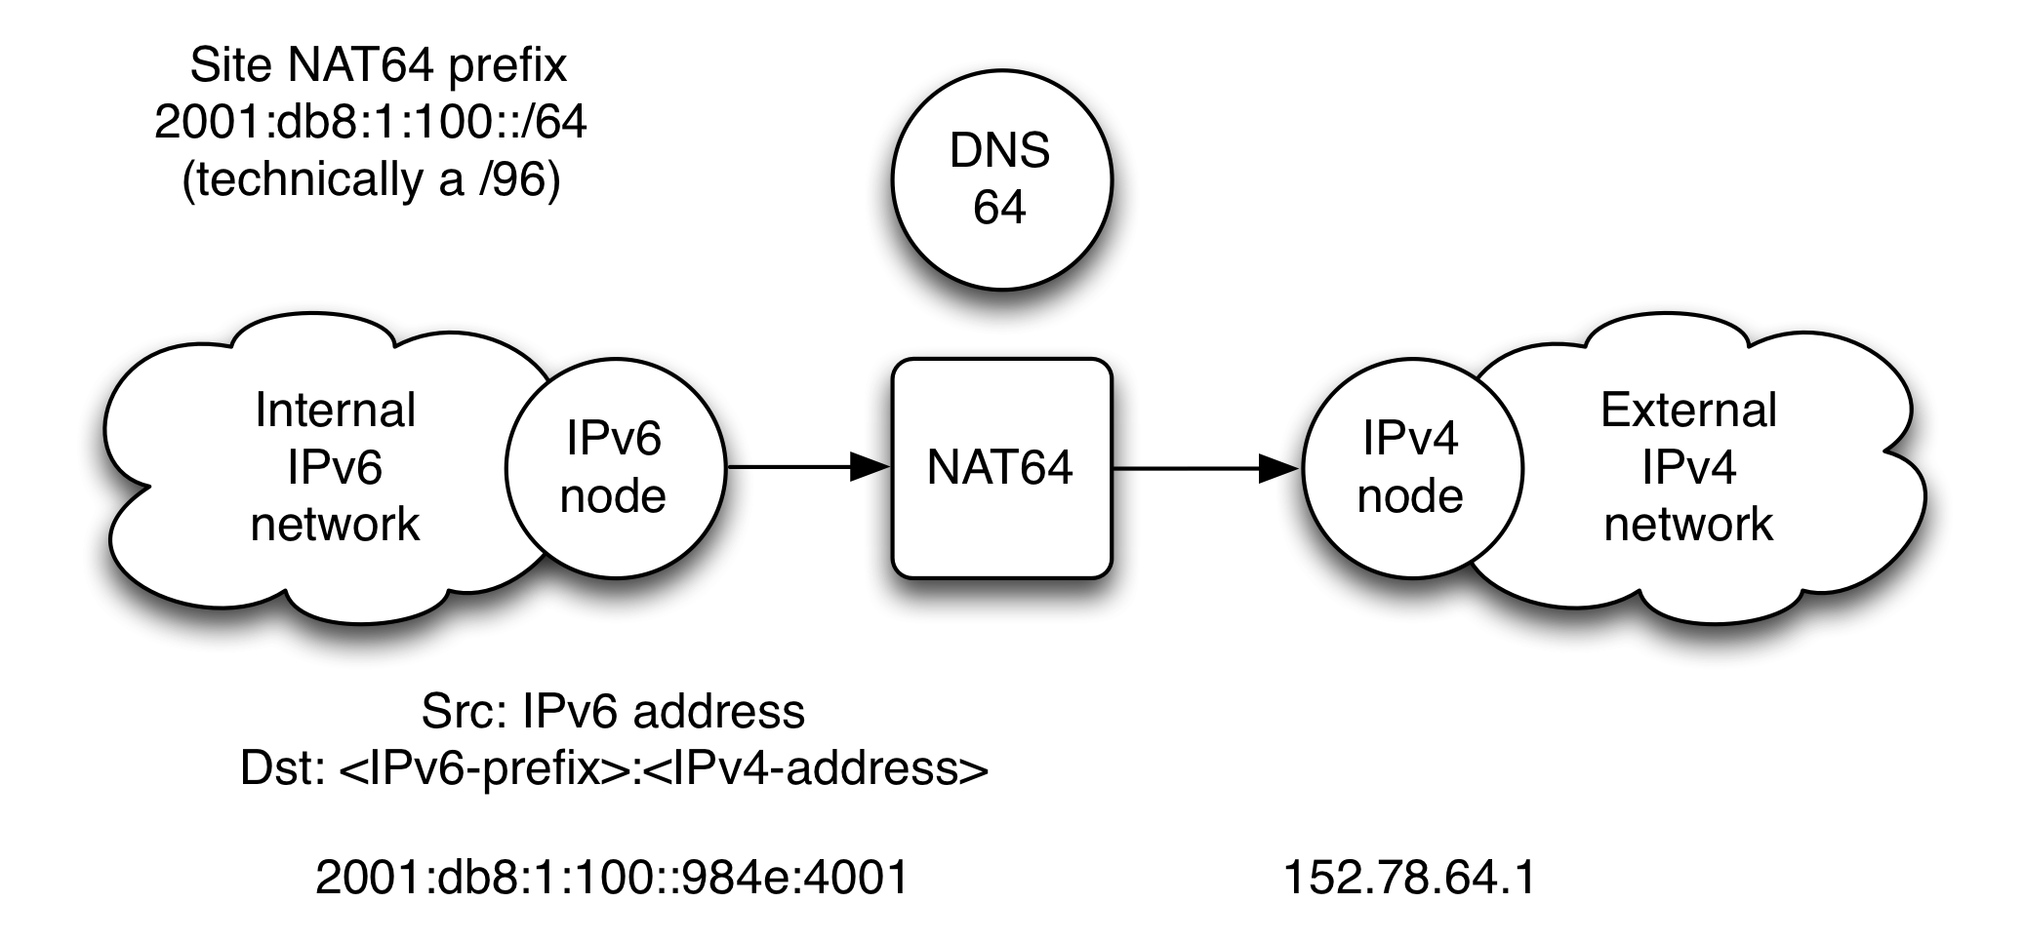
NAT64 / DNS64 example
The ‘trick’ is use of DNS64, which returns a ‘fake’ IPv6 address formed by appending the IPv4 address to the site’s chosen NAT64 prefix, and the IPv6-only client sends to that address, with the NAT64 box doing the address and protocol conversion (out and back)

Slide 47
When can I remove IPv4?
Simplifying your IPv6 deployment longer term
The prudent initial deployment approach is currently dual-stack
But the question soon becomes “where can I remove IPv4?”
  Internal management network? (Facebook is 100% IPv6 internally)
  On your site WiFi?
  For research communities? The WLCG is heading this way
You will likely need to deploy tools that support IPv6-only devices accessing IPv4-only content, such as NAT64/DNS64/464XLAT
  But will all your applications work when using such tools?
  The more you use IPv6 for applications, the less you need translation

Slide 48
“IPv6-Mostly”
An approach to removing IPv4 in host subnets
Some campuses have deployed dual-stack WiFi networks
Ideally move towards IPv6-only
The “IPv6-Mostly” approach allows hosts to use receipt of DHCPv4 option 108 to disable IPv4 and use their IPv6 CLAT
  IPv4-only systems continue to use IPv4
  See draft-ietf-v6ops-6mops and RFC 8925
Deployed here at Imperial
  See https://www.ipv6.org.uk/2024/10/04/2024-annual-meeting/

Slide 49
What about DNS?
It’s the same, but different
Delegation happens as per IPv4 for forward and reverse DNS
  Use AAAA records for IPv6 where you use A records for IPv4
  Reverse DNS for IPv6 is nibble-based under ip6.arpa
    So would be under 8.b.d.0.1.0.0.2.ip6.arpa for 2001:db8::/32
All common IPAM systems should support IPv6
  Infoblox is quite a popular solution used in R&E sites
Don’t add a host’s AAAA entry to DNS until all services on it support IPv6 else there will be nothing listening for the connection
[Aside: Jisc offers a primary and secondary DNS service, and a network resolver service with RPZ built-in for malware protection]

Slide 50
A phased approach to deploying IPv6
Most guidance distils down to a phased approach
Planning
  Acquiring address space, forming an address plan, training, platform review, security policies
  Ensuring IPv6 requirements set in procurements (even if not turning IPv6 on yet)
  Choose how you will do host configuration
Piloting / testing
  Form a test plan, deploy a testbed, perhaps connect testbed directly to your edge router
Production
  Choose a deployment target (public services, WiFi, etc.), confirm dual-stack approach
  Build support from the core first: edge connectivity, firewalling, backbone, DNS
  Ensure your monitoring and management tools work with IPv6
  Then turn on IPv6 in the selected edge network (router advertisements, etc.)
Ongoing build-out and enhancement
  Business as usual

Slide 51
IPv6 Security
What’s different?

Slide 52
Security
Need to implement your policy for both IP versions
Leaving IPv6 ‘open’ is not a great idea
Dual-stack means you need to support / manage both protocols
  Look to use tools that manage objects consistently, e.g. by using dual-stack firewall objects not separate IPv4 and IPv6 objects
Focus where possible on feature equivalence
  RA Guard is as important as DHCPv4 Guard, ARP vs DAD spoofing
But recognise new threats
  e.g., abuse of IPv6 extension headers
And differences
  Classic IP scanning has changed over time for IPv6

Slide 53
Some good IPv6 security resources
At the Council and UKNOF
IPv6 Security book (Vyncke and Hogg)
  https://hoggnet.com/pages/ipv6-security
Scott Hogg: Large-scale Internet reconnaissance:
  https://www.ipv6.org.uk/2025/10/24/annual-meeting-2025/
  Presents a wide variety of new ways that attackers have devised – you’d can’t just rely on hiding in a big space
David Holder @ UKNOF (2019):
  IPv6 Security [video] [slides]
  General coverage

Slide 54
Finding more information

Slide 55
IPv6 resources
Some useful links
Jisc material:
  IPv6 service page: https://www.jisc.ac.uk/ipv6
  Advice and guidance page: https://www.jisc.ac.uk/guides/how-to-begin-an-ipv6-deployment
  Janet IPv6 Technical Guide: https://repository.jisc.ac.uk/8349/1/janet-ipv6-technical-guide.pdf
  Training: https://www.jisc.ac.uk/training/ipv6-fundamentals
  JiscMail ipv6-users@jiscmail.ac.uk list, subscribe at https://jiscmail.ac.uk/IPv6-users
Other sources:
  UK IPv6 Council: https://www.ipv6.org.uk/ - recent talks on GridPP and AWS support
  book6: community book - https://github.com/becarpenter/book6/
  UKNOF/NetUK: https://www.uknof.org.uk/ and https://www.netuk.org/ - many talks on IPv6
  Procurement : https://www.ripe.net/publications/docs/ripe-772 (updated - was RIPE 554)

Slide 56
Contact:
Tim Chown
tim.chown@jisc.ac.uk
4 Portwall Lane, Bristol, BS1 6NB

